Slide 1

EXPERIMENTAL INVESTIGATION OF THERMODYNAMIC PERFORMANCE AND CO₂ EMISSIONS ANALYSIS OF VCR SYSTEM BY VARYING THE LENGTH OF CAPILLARY TUBE
N. Roshan vali
Roll No. 224G5A0328
K. Jayavanth kumar
Roll No. 224G5A0314
by
P.Jagadeesh
Roll No. 214G1A0310
C.Akhil kumar reddy
Roll No. 224G5A0302
G.Kartheek
Roll No. 214G1A0311
Under the guidance of
Dr.Shaik Sharmas Vali M.Tech.Ph.D
Associate Professor
Department of Mechanical Engineering
Srinivasa Ramanujan Institute of Technology
(Autonomus)
2024 - 2025

Slide 2
Contents
Abstract
Problem statement
Objectives of Project
Methodology
Conclusion
Literature survey
References
Queries
Srinivasa Ramanujan Institute of Technology
2

Slide 3
Abstract
The Capillary tube is a critical component in Vapour compression refrigeration (VCR) system, Serving as an expansion device to regulate refrigerant flow. This study investigates the effect of capillary tube length on the performance of a VCR system, Focusing on cooling capacity, Coefficient of performance (COP). By varying the capillary tube length, experimental and computational analysis were conducted to evaluate system behavior under different operating conditions and two different Refrigerants such as R134a, R600a & R290 mixture. The results indicate that capillary tube length significantly influences refrigerant flow rate, pressure drop, and system efficiency by comparing two refrigerants. An optimal length ensures stable operation, enhances COP, While excessively short or long tubes lead to inefficiencies such as overfeeding or underfeeding of refrigerants.
Additionally, A computation-based CO2 emission analysis was performed to assess the environment impact of the system under varying capillary tube lengths, Comparing effects of two refrigerants.
.
Srinivasa Ramanujan Institute of Technology

Slide 4
Problem Statement
Calculation of COP in Vapour Compression Refrigeration System By Varying lengths of Capilary tube takes lots of time Due to various outcomes upto Performance is increased.
Computation of CO2 Emission Analysis of R134a & R600a Refrigerants may lead to Critical Analysis of Variations.
Srinivasa Ramanujan Institute of Technology

Slide 5
Objectives of Project
ThermoDynamic Performance Analysis: Optimization of performance in Vapour Compression Refrigeration System by Varying the length of Capilary tubes.
To compute the CO2 Emission Analysis: By comparing the Natural Refrigerant (R134a) and R600a Refrigerant analyse the CO2 Emission. And may prove that R600a significantly has lower CO2 Emission and more Environmentally friendly.
Srinivasa Ramanujan Institute of Technology

Slide 6
METHODOLOGY:
Steady-state data: Collect data when the system reaches steady-state conditions for each capillary tube length.
Performance parameters: Measure and record the following performance parameters:
Mass flow rate
Refrigeration Effect
Compressor Work
Coefficient of performance
Discharge Temperature
Pressure Ratio
Volumetric refrigerator Capacity
Power Per Ton of Refirgerator

Slide 7
Theoretical Calculations
Refrigerant | Refrigeration effect (kj/kg) | Compresr work (kj/kg) | Coefficient Of Performance | Pressure Ratio | Total Discharge | Mass Flowrate (kg/s) | PPTR (kw/Tr) | VRC (kj/m³)
R134a | 1.475 | 61.5 | 2.398 | 13.812 | 85 | 0.0238 | 1.465 | 758.57
R600a | 227.5 | 87.5 | 2.6 | 12.5 | 65 | 0.0154 | 1.3527 | 386.75

Slide 8
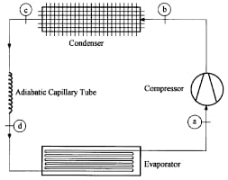
Vapour Compression Refirgeration System

Slide 9
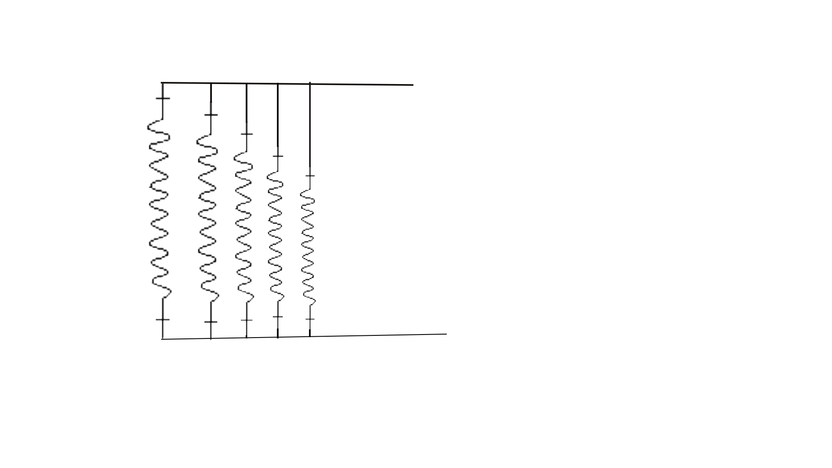
From condenser
Capillary tubes of varying lengths
To evaporator

Slide 10
Basic Properties of Refrigerants
Refrigerants | Mv (G/mol) | Bp ⁰c | Pc (mpa) | Tc ⁰c | ODP | GWP 100 Years
R134a | 102.3 | -26.07 | 4.059 | 101.06 | 0 | 1530
R600a | 58.12 | -11.75 | 3.629 | 134.66 | 0 | 3

Slide 11
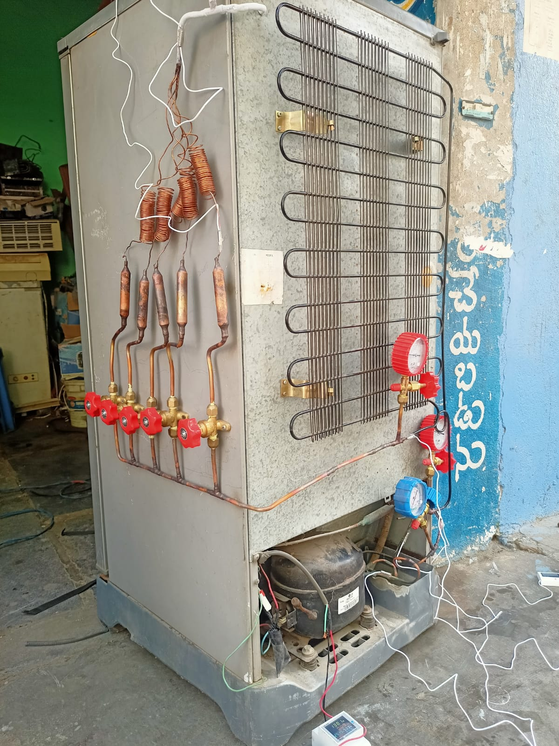
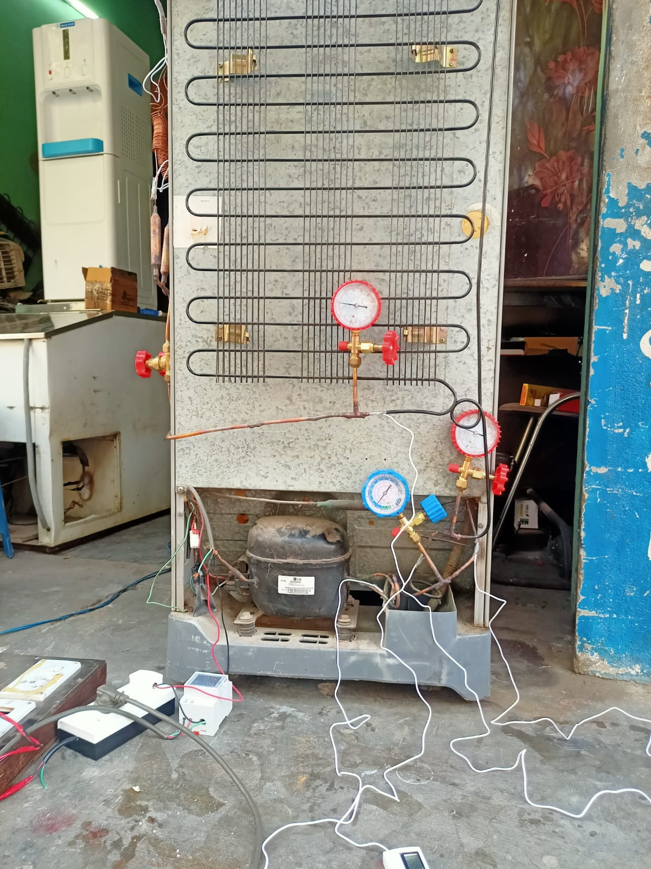
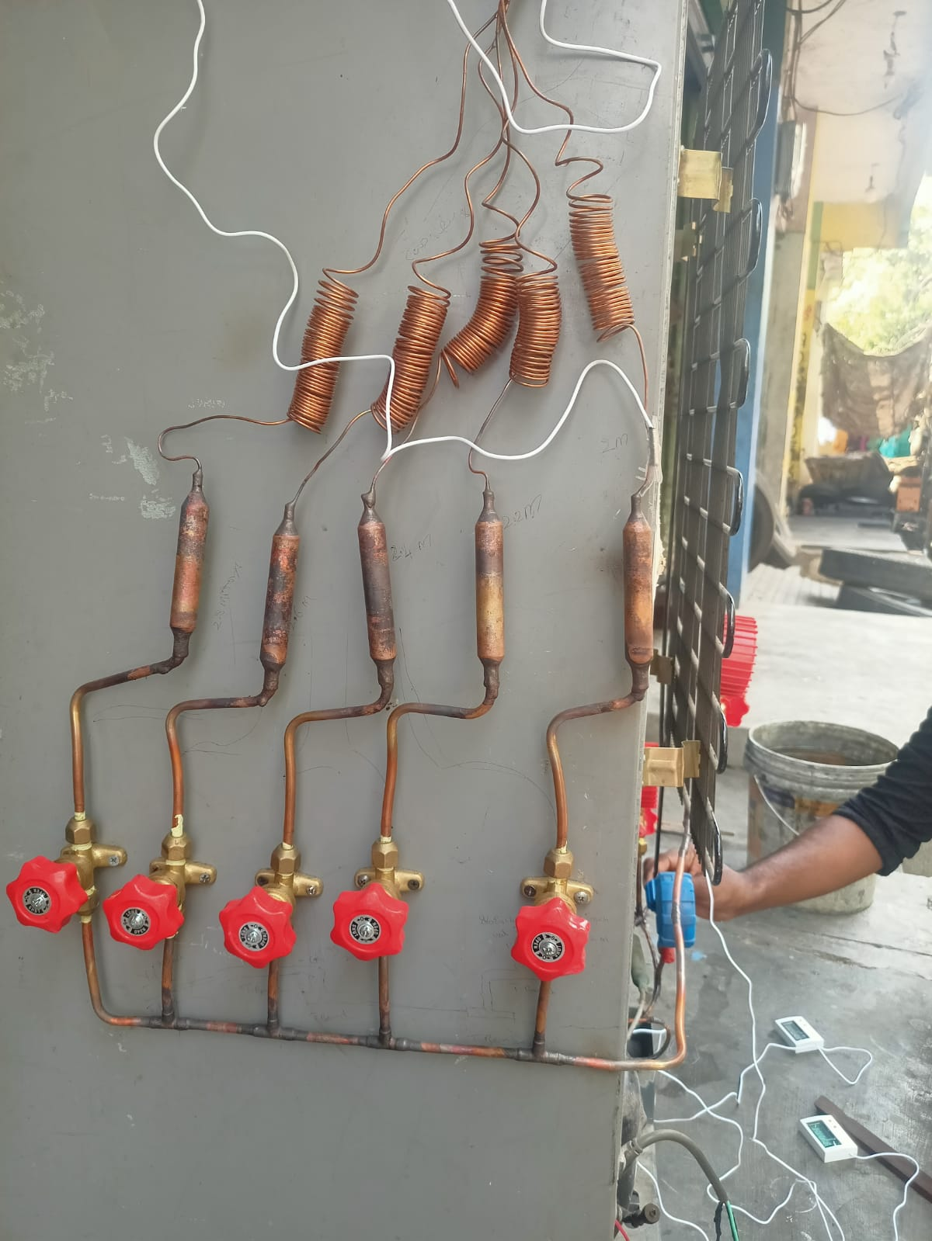
Project Photos:

Slide 12
Experimental readings on R134a Refrigerant of Various Parameters:
Length of capillary tube | 2 meter | 2.2 meter | 2.4 meter | 2.6 meter | 2.8 meter
Mass flow rate (kg/s) | 0.7724 | 0.7724 | 0.7466 | 3.2 | 0.8
Refrigeration effect (kj/kg) | 145 | 145 | 150 | 35.0 | 140
Compressor work (kj/kg) | 70 | 70 | 70 | 80 | 66
Coefficient of performance | 2.07 | 2.07 | 2.14 | 0.43 | 2.12
Pressure ratio | 18.68 | 21.11 | 18.50 | 21.66 | 20.0
Volumetric refrigeration capacity (kj/m³) | 464 | 464 | 510 | 112 | 462
Power per ton of refrigerator | 0.5744 | 0.5890 | 0.6093 | 0.1244 | 0.6031

Slide 13
Experimental readings on R600a & R290 Mixture Refrigerant of Various Parameters:
:
Length of Capillary tube | 2 meter | 2.2 meter | 2.4 meter | 2.6 meter | 2.8 meter
Mass flow rate (kg/s) | 0.5090 | 0.5490 | 0.5558 | 0.6037 | 0.5947
Refrigeration effect (kj/kg) | 220 | 204 | 201.5 | 185.5 | 188.3
Compressor work (kj/kg) | 88 | 87 | 87.5 | 92.5 | 91.6
Coefficient of performance | 2.5 | 2.3 | 2.3 | 2.0 | 2.05
Pressure ratio | 11.05 | 10.25 | 10 | 11.2 | 10.87
Volumetric refrigerator capacity (kj/m³) | 814 | 856.8 | 785.85 | 723.45 | 847.35
Power per ton of refrigeration | 0.7108 | 0.66 | 0.65 | 0.57 | 0.58

Slide 14
TEWI Calculation Of Refrigerants:
Length (meters) | TEWI for R600a/R290 | TEWI for R134a
2 | 7502 | 165.68
2.2 | 7330 | 162.62
2.4 | 7707 | 163.55
2.6 | 7707 | 171.63
2.8 | 7491 | 171.80

Slide 15
Conclusion:
This study examined the effect of varying capillary tube lengths on the performance and environmental impact of a refrigeration system. Based on the analysis, it was observed that a shorter capillary tube length of 2.0 meters delivers the highest refrigeration effect and COP, indicating superior cooling performance. However, as the length increases, both cooling capacity and efficiency decrease, while energy consumption improves slightly.
From an environmental perspective, the Total Equivalent Warming Impact (TEWI) calculations reveal that a capillary length of 2.2 meters results in the lowest CO₂ emissions, making it the most environmentally favorable option. Although 2.4 and 2.6 meters offer lower power per ton, they are associated with the highest TEWI values due to reduced overall performance.
Therefore, it can be concluded that a capillary tube length of 2.2 meters offers the best compromise between system efficiency, power consumption, and environmental sustainability, and is recommended as the optimal configuration for practical applications in refrigeration systems.

Slide 16
Literature survey
Author Article Title Journal Details Observations
Y.Chandra sekhar
Yadav,
B. Naga shiva
prasad reddy,
Dr. D.V Sreekanth
This review highlights the effect of Capillary tube length on the performance of Vapour Compression Refrigeration System.
The effect of Capillary tube length on the performance of Vapour Compression Refrigeration System
Compliance Engineering Journal
Srinivasa Ramanujan Institute of Technology

Slide 17
References
Wong, T.N. and K. T. Ooi (1996) Evaluation of capillary tube performance for CFC-12 and HFC 134a, International Communications in Heat and Mass Transfer, 23, 993-1001
Bansal. P.K. and A.S. Rupasinghe (1996) An empirical model for sizing capillary tubes, International Journal of Refrigeration, 19, 497 505.
Srinivasa Ramanujan Institute of Technology

Slide 18
Any Queries?
Srinivasa Ramanujan Institute of Technology

